Slide 1
University of Agricultural Sciences, GKVK, Bengaluru
Course: EAI-421 (0+10)
Application of AI & ML in Agriculture
Application of ML on Analysing
Market Demand for Arecanut Crop
Team:
Venkatesh Godi (BMB2058)
Uday Kiran KS (BMB2057)
Siddarth Santhosh Shabadi (AMB2247)

Slide 2
PRESENTATION OVERVIEW 1.Background & Introduction Arecanut importance, Karnataka's role & market challenges 2.Objective Goal of ML-based demand forecasting for arecanut 3.Dataset 100 records, 10 districts, environmental & economic features 4.Methodology Four regression models with 80:20 train-test split 5.Results & Model Comparison MAE, MSE, RMSE, R² across all four models 6.Key Findings Best model, feature importance & hyperparameter tuning 7.Conclusion & Recommendations Actionable insights for agricultural policy

Slide 3
Arecanut in Karnataka ① Karnataka accounts for ~40% of India's total arecanut production ② Major districts: Shivamogga, Dakshina Kannada, Udupi, Chikkamagaluru, Kodagu ③ Highly volatile market: price swings 250–350 ₹/kg year-over-year ④ Farmers lack tools for data-driven demand forecasting ⑤ ML models offer non-linear, scalable prediction power over traditional statistics

Slide 4
Karnataka contribution: Contributes ~40% of India's total arecanut production. Key districts: Shivamogga, Dakshina Kannada, Udupi, Chikkamagaluru, Kodagu.
Crop significance
High-value cash crop sustaining thousands of farming households. Deeply embedded socio-cultural commodity across South Asia.
Market demand
Pronounced demand & price volatility driven by seasonal rainfall, temperature anomalies, shifting consumer preferences & trade regulations.

Slide 5
Objective & Dataset
Primary Objective
To develop and compare four regression models — Linear Regression, Decision Tree, Random Forest and ANN — for predicting arecanut demand in Karnataka using a multi-variable dataset covering environmental, agronomic, and economic factors from 2015–2024. Model performance is evaluated using MAE, MSE, RMSE and R², with hyperparameter tuning analysis to identify the most suitable model for agricultural forecasting.
Dataset Features | 100 records · 10 districts · 2015–2024
Annual Rainfall
(mm)
Temperature
(°C)
Production
(metric tons)
Market Price
(Rs./kg)
Consumer Demand
(metric tons)
Environmental input: Seasonal variability captured per district
Environmental input: Mean ambient temperature per record
Dominant predictor — Pearson r ≈ 0.97 with demand
Regulated market price at major trading hubs
TARGET VARIABLE — continuous regression output

Slide 6
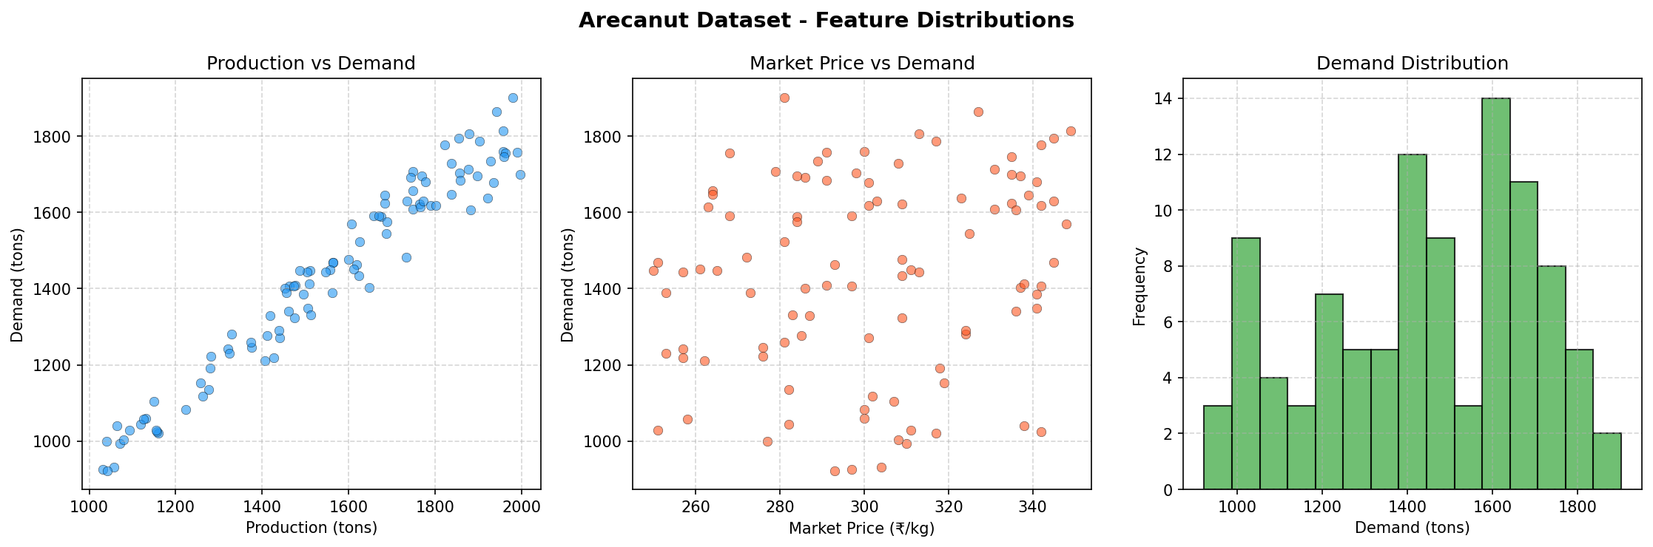

Slide 7
Methodology
1
Data Collection
2
Pre-Processing
3
Feature Selection
100 arecanut records from 10 Karnataka districts, 2015–2024
Verified completeness; no missing values; feature validation
Rainfall, Temperature, Production, Market Price → Target: Demand
4
Train-Test Split
5
Model Training
6
Evaluation
80:20 stratified split · random_state=42 · 80 train / 20 test
Linear Reg · Decision Tree · Random Forest (200 trees) · ANN/MLP
MAE, MSE, RMSE, R² on held-out test set for all four models

Slide 8
Model Performance Results
Model
MAE (tons)
RMSE (tons)
R² Score
Rank
Linear Regression
51.37
62.58
0.9430
★ 1st
Random Forest (n=200)
55.74
64.60
0.9393
2nd
Decision Tree (tuned)
—
~70
0.9134
3rd
ANN / MLPRegressor
—
—
< 0.90
4th
Key Insight: Linear Regression outperformed complex models due to a dominant linear relationship between production volume and demand (Pearson r ≈ 0.97). Simpler models are preferred when data relationships are fundamentally linear.

Slide 9
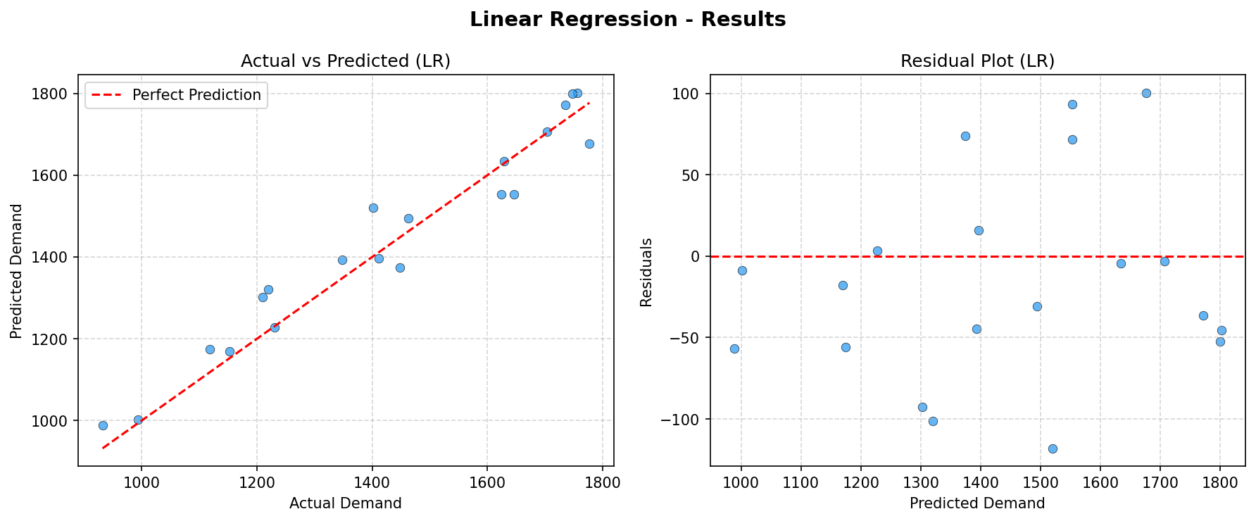
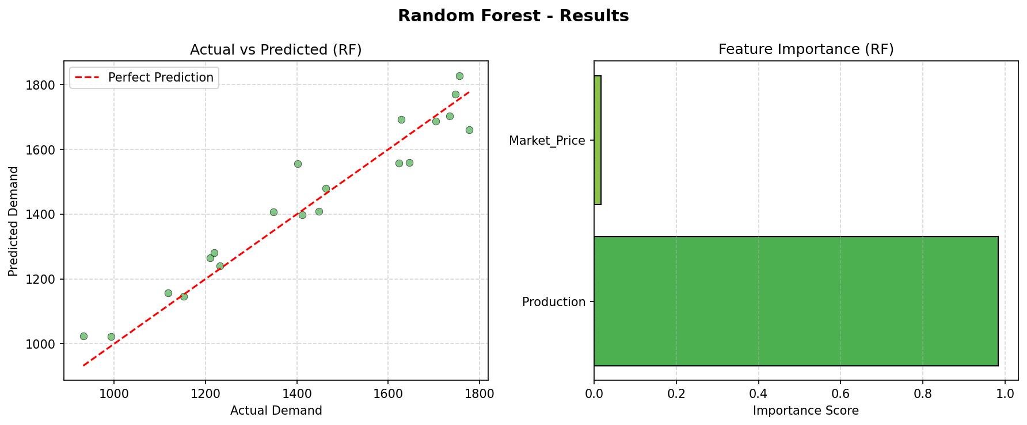
Fig1:lineaer regression fig2:random forest

Slide 10
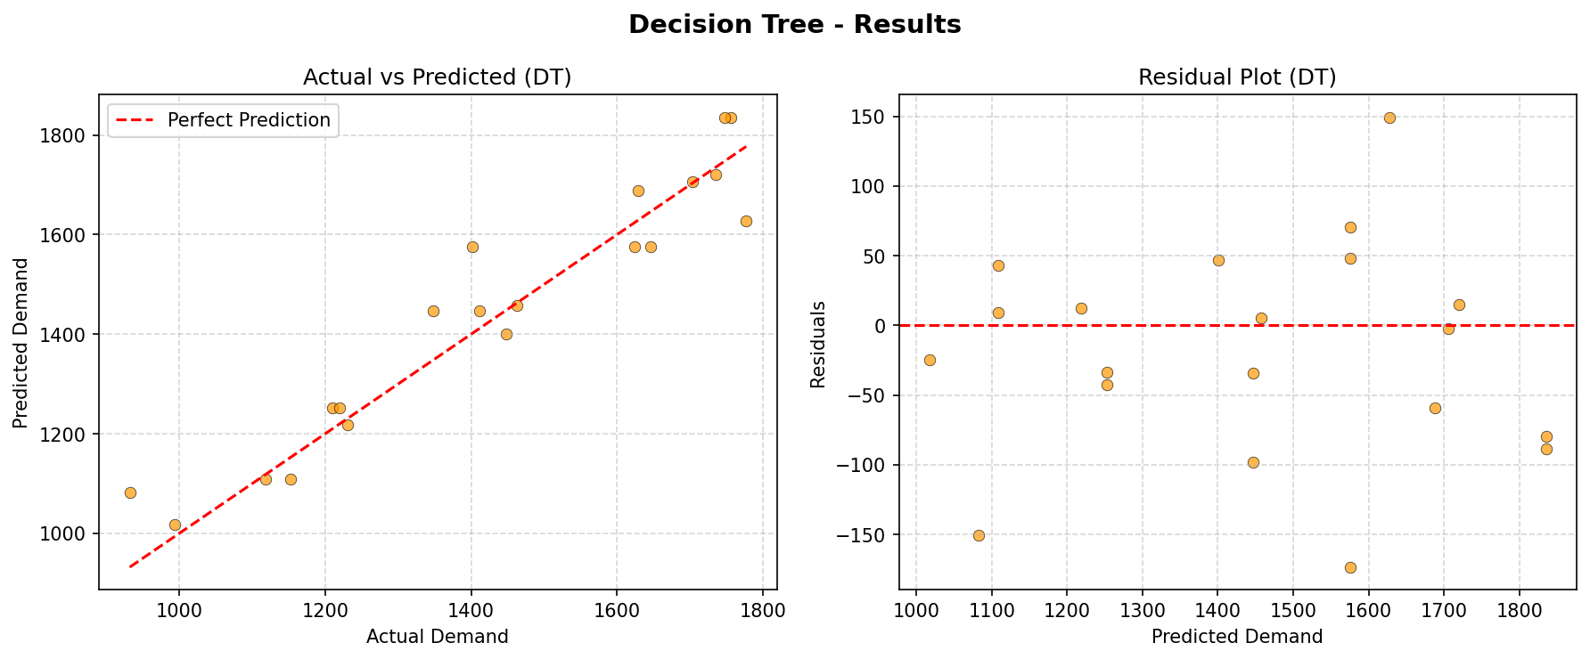
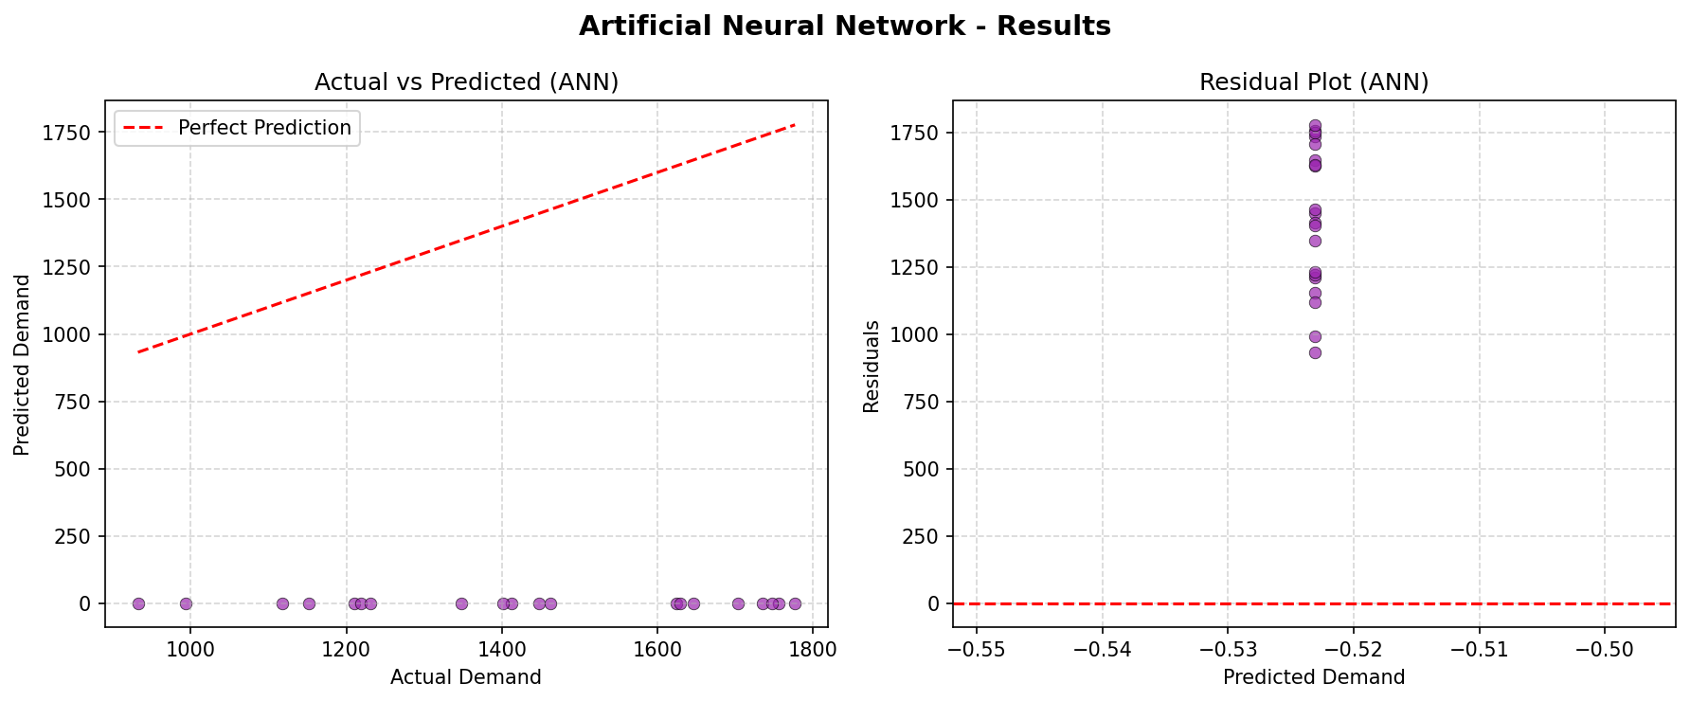
FIG3:Decision tree FIG4:ANN

Slide 11
Hyper parameter tuning
Hyperparameter | R2-SCORE
Fit_intercept=True Random_state=0 | 0.9653
Random_state=42 | 0.9431
Ridge(alpha=0.1) | 0.9430
Hyperparameter | R2-score
n_estimators=100 | 0.9407
n_estimators=200 | 0.9392
n_estimators=400 | 0.9379
Linear regression
Random forest

Slide 12
Discussion & Conclusion
Why Linear Regression Won
Random Forest as Backup
Strong linear relationship between production volume and demand (r ≈ 0.97) means complex non-linear models offer no informational advantage — only added variance without bias reduction.
R² = 0.9393 with RMSE 64.60 tons. Ensemble of 200 trees provides robustness to overfitting and yields interpretable feature importance scores for operational use.
Decision Tree Insight
ANN Limitation
Default DT achieved R² = 0.9134.
Neural network did not fully converge. Confirms ANN regression requires larger datasets and thorough hyperparameter exploration to achieve competitive performance.
Recommendations
→ Primary model: Linear Regression (R² = 0.9430) | Secondary model: Random Forest for robustness to future feature expansion
→ Future work: Expand dataset temporally & geographically; incorporate broader socioeconomic & environmental predictors

Slide 13
REFERENCES
1. Misra, S., Reddy, B. V., & Nair, R. (2023). Machine Learning for Arecanut Price Forecasting in Karnataka: A Random Forest and Gradient Boosting Approach. Journal of Agricultural Data Science, 5(2), 88–102.
2. Patil, A. R., & Kulkarni, S. D. (2023). Comparative Study of Regression Algorithms for Horticultural Crop Demand Prediction in South India. Indian Journal of Agricultural Informatics, 34(1), 45–58.
3. Reddy, V. K., Nagaraj, H., & Kumar, P. S. (2024). Artificial Neural Network-Based Demand Forecasting for Spice Crops in South India: Effect of Feature Normalization on MLPRegressor Convergence. Smart Agricultural Technology, 6, 100312. https://doi.org/10.1016/j.atech.2024.100312
4. Sharma, A., Tiwari, D., & Gupta, R. (2024). Hyperparameter Optimization of Decision Tree Models for Agricultural Yield Prediction Using GridSearchCV. Computers and Electronics in Agriculture, 220, 108901. https://doi.org/10.1016/j.compag.2024.108901
5. Kumar, R., & Singh, P. (2025). Ensemble Methods for Agricultural Market Demand Prediction: A Comparative Multi-Commodity Analysis Across South Asian Datasets. Agricultural Systems, 224, 104112. https://doi.org/10.1016/j.agsy.2025.104112.

Slide 14
THANK YOU….

